Slide 1
Planning with the Five Criteria
Ozarka College
This PowerPoint was made in 2008 and slightly updated in August 2009. It explains the current yearly planning process used at Ozarka and its rationale.

Slide 2
Today’s Topics
1
Who we are and need for change
2
Advantages of and why use the Five Criteria for planning
3
Products produced: Planning Manual, Planning Results Manual, Review of Planning Results Manual
4
Structure of and process for producing the three manuals
5
Changes in 2008-2009 and conclusions

Slide 3
Who Are We?
Rural 2-yr CC
1300 students, 800 FTE
90 employees 30 faculty
Three sites, four counties
75% female

Slide 4
Need for Change
One brainstorming session
Board of Trustees and Administration
Documented successes but not thorough
Eventually included faculty
Previous planning included:

Slide 5
Why the Five Criteria?
Why the Five Criteria?
Evolved over 111 years
Updated in participatory process
Product includes insight of Ozarka and Authors

Slide 6
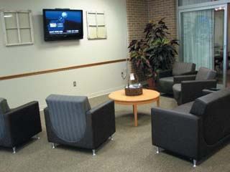
Advantages of Planning with the Five Criteria
All
participate
All learn about the Five Criteria
Documentation for Accreditation

Slide 7
Planning Manual
2006-07
2007-08
2008-09
2009-2010
Planning Results Manual
2006-07
2007-08
2008-09
Review of Planning Manual
2006-2007
Products

Slide 8
Structure of Planning Manual
Primary Goals
(Five Criteria)
Priority Initiatives
(Core Components)
Strategies
(Examples of Evidence)
Actions
(Planning by Ozarka)

Slide 9
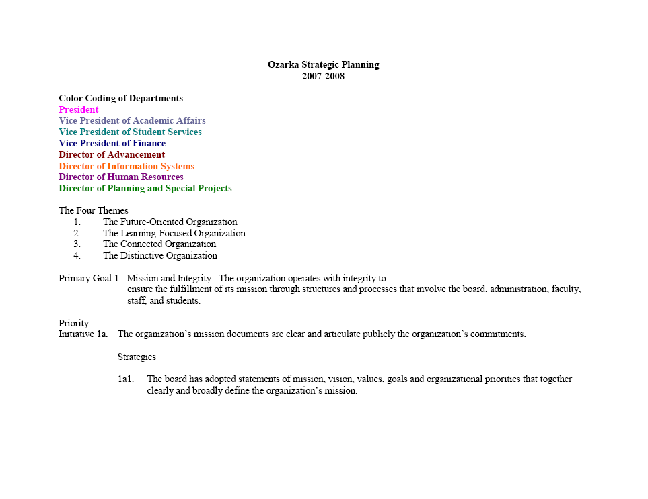

Slide 11
Directions for Planning with the Five Criteria
Step 1
Make list of what you want to accomplish
Step 2
Read Five Criteria and find a place for your plans
Step 3
While reading the Five Criteria, make a list of things you should be doing but you are not.
Step 4
If you cannot find an appropriate place, we will make one
Step 5
Tie assessment to planning and planning to budgeting where possible.

Slide 12
First Step: Make a List of What You Want to Accomplish
Faculty
AST instructor will attend two professional meetings
Library
Will continue to research and modify its effectiveness through student survey analysis

Slide 13
First Step: Make a List of What You Want to Accomplish
Finance
Various members will attend SACUBO and procurement training
President
Ozarka will provide community access to computer labs

Slide 14
Second Step: Read Through Five Criteria and Find Place
3b6. The organization supports faculty in keeping abreast of the research on teaching and learning and of technological advances that can positively affect student learning and the delivery of instruction.
AST instructor will attend two professional meetings

Slide 15
Second Step: Read Through Five Criteria and Find Place
3d2. The organization evaluates the use of its learning resources to enhance student learning and effective teaching.
The library will continue to research and modify its effectiveness through student survey analysis

Slide 16
Second Step: Read Through Five Criteria and Find Place
4a3. The organization supports professional development opportunities and makes them available to all administrators, faculty, and staff.
Various members of finance will attend SACUBO and procurement training

Slide 17
Second Step: Read Through Five Criteria and Find Place
4a2. The organization’s planning and pattern of financial allocation demonstrate that it values and promotes a life of learning for its students, faculty, and staff.
The college will provide community access to computer labs

Slide 18
Third Step: Check out the Five Criteria for Things You Should Be Doing
1a5. The organization regularly evaluates and, when appropriate, revises the mission documents.
New president, old mission statement – time for a review
“Ozarka College provides life-changing experiences through education.”

Slide 19
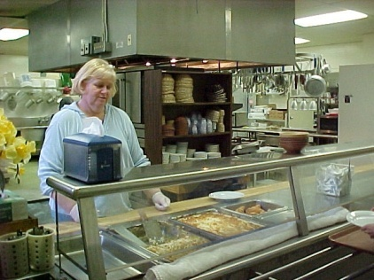
Fourth Step: We Will Create a New Category if You Cannot Find One
The cafeteria will continue to provide quality dining experiences for students, staff, and community and civic groups.
5d7. The organization provides programs and services to meet the needs of the internal and external communities.

Slide 20
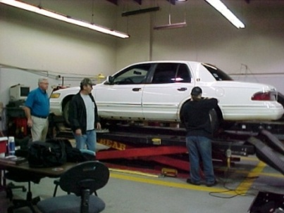
Sample from Planning Results Manual
Planning Manual - The AST instructor will attend at least two professional development meetings.
Planning Results Manual - Done. Skills USA and National Auto Diesel College for 30 hours of training
3b6. The organization supports the faculty in keeping abreast of the research on teaching and learning….

Slide 21
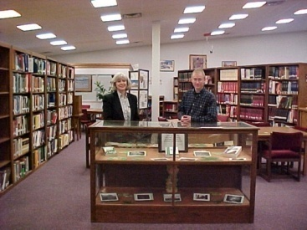
Sample from Planning Results Manual
Planning Manual – The library will continue to research and modify its effectiveness through…
Planning Results Manual – Changes made after survey include cell phone policy and online data base supplier changed
3d2. The organization evaluates the use of its learning resources to enhance…

Slide 22
Review of Planning Results 2006-2007
1.
Three faculty members and two administrators volunteered.
2.
Each reviewer assigned a primary goal (criterion).
3.
Each reviewer given two copies of model self-studies as a reference tool
4.
Summary of committee recommendations sent out prior to next planning cycle

Slide 23
Review of Planning Results
Criterion 2:
Preparing for the Future
2a: Realistically prepares for the future
2b: Resource base supports its educational programs
2c: Evaluation and assessment processes provide reliable evidence of effectiveness
2d: All levels of planning align with the organizations mission
For example under Core Component 2d “Planning processes link with budgeting processes.”

Slide 24
Review of Planning Results
A review of Criterion 2 revealed that assessment should be tied to budgeting and budgeting to planning such as:
2a2: ADHE assessment indicates a lower than desired retention rate therefore a Student Success Specialist will be budgeted for in the upcoming Perkins grant.
Criterion 2:
Preparing for the Future
2a: Realistically prepares for the future
2b: Resource base supports its educational programs
2c: Evaluation and assessment processes provide reliable evidence of effectiveness
2d: All levels of planning align with the organizations mission

Slide 25
Significant Change in 2008-2009
New for this year (Fifth Step)
Tie assessment to planning where possible
Tie planning to budgeting where possible

Slide 26
Examples with Assessment/Budgeting
2a3: Evaluation of Ozarka demographics indicates little natural exposure to diversity therefore Student Services will budget for three activities exposing students to other cultures

Slide 27
2c2: With student retention less than desired, Information Systems will budget time for creating an assessment tool whereby advisors can quickly determine which students need assistance

Slide 28
Conclusions after 3 Years: Successes
Knowledge of and documentation of Five Criteria
Promotes what Ozarka and HLC deem important
Definitive assessment, planning, budgeting and documentation cycle established

Slide 29
Conclusions after 3 Years: Challenges
Buy in and quality takes time
Buy-in causes document to grow large
Strategic planning is a challenge
Challenges

Slide 30
Activity Sheet
Department of Planning and Special Projects
Planning with the Five Criteria
Here is a list of five of the items the Planning and Special Projects Department wanted to accomplish:
A. Planning will conduct an annual alumni survey and budget postage/printing.
B. Grant management will continue to follow federal, state and college guidelines.
C. Ozarka College will continue to provide meeting space for Safe Passage, a community women’s advocacy organization.
D. With a historical retention rate of less than 60%, the Student Success Specialist and the Director of Planning and Special Projects will visit a model school for retention and attend a retention conference and will budget for these professional development activities though Perkins.
E. Based on Ozarka retention data and travel to Mid South Community College (MSCC) to examine MSCC’s approach to retention, new Student Success Centers will be fully operational by fall of 2008 on all three campuses with a budget for supplies/tutors.
Try to match the above list to the Strategies (Examples of Evidence for HLC) below. For activity purposes, one item from the above list fits one Strategy below.
Mission and Integrity
_____1e3. The organization understands and abides by local, state, and federal laws and regulations applicable to it (or bylaws and regulations established by federally recognized sovereign entities).
Preparing for the Future
_____2a5. The organizational environment is supportive of innovation and change.
Student Learning and Effective Teaching
_____3a2. Assessment of student learning provides evidence at multiple levels: course, program, and institutional.
Acquisition, Discovery and Application of Knowledge
_____4a3. The organization supports professional development opportunities and makes them available to all of its administrators, faculty, and staff.
Engagement and Service
_____5d5. The organization’s facilities are available to and used by the community.

Slide 31
P.O. Box 10
Melbourne, AR 72556
870-368-7371
www.ozarka.edu

